Slide 1
OADII Software Foundry: Programming Language Skills Essentials: Introduction to C++: Course Introduction & Overview
Dean Hougen
School of Computer Science
University of Oklahoma

Slide 2
OADII Software Foundry
Software Foundry is offering a collection of nine courses specifically developed for professionals in the aerospace and defense industry.
FSE: Fundamentals of Software Engineering Practices
Introductions to concepts and methods central to aerospace and defense software; hands-on using Python
PLS: Programming Language Skills Essentials
Introductions to languages widely used in aerospace and defense for people with prior programming
ASE: Advanced Software Engineering Practices
Crucial concepts and methods for aerospace and defense software; hands-on using Python

Slide 3
Course Flow Diagram
No prior knowledge of
aerospace software systems
Fundamentals of Software Engineering Practices
Introduction to Aerospace Software Systems
Little or no
experience with
software development
Familiarity with
aerospace software systems
Introduction to Software Tools and Practices
Familiarity with Python and
software tools and practices
Software Fundamentals Practicum
Advanced Software Engineering Practices
Programming Language Skills Essentials
Introduction to Software Requirements and Specifications
Introduction to Java
Translation Between Java and C++
Programming Experience
Some experience with
software development
Introduction to Cybersecurity
Introduction to C++
Introduction to Software Testing
Familiarity with Java or C++

Slide 4
PLS: Programming Language Skills Essentials
Course Group Description: Introductions to languages widely used in aerospace and defense for people with prior programming experience; hands-on
Introduction to Java
Introduction to C++
Translation between Java and C++

Slide 5
PLS: Introduction to C++
Prerequisites: Fundamentals of Software Engineering Practices or experience with programming and software tools and practices.
Course Description: Introduction to object-oriented programming in C++. Emphasis on language features and libraries for efficient and effective programming. Topics include abstraction and modularization, object-oriented design, inheritance, polymorphism, virtual and pure virtual classes, templates, events, exceptions, and Standard Library Containers.

Slide 6

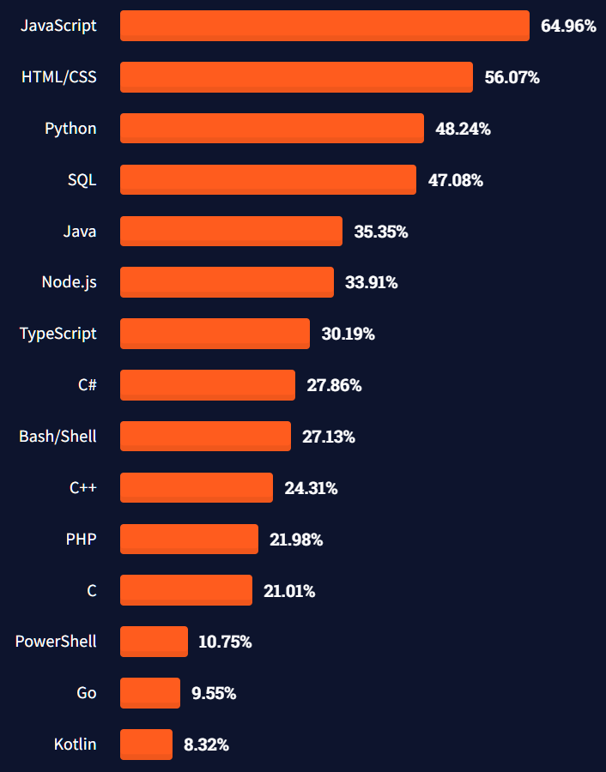
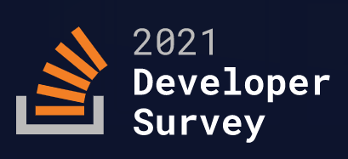
Why C++?
Widely used
Stack Overflow survey
https://insights.stackoverflow.com/survey/2021#most-popular-technologies-language
83,052 responses

Slide 7

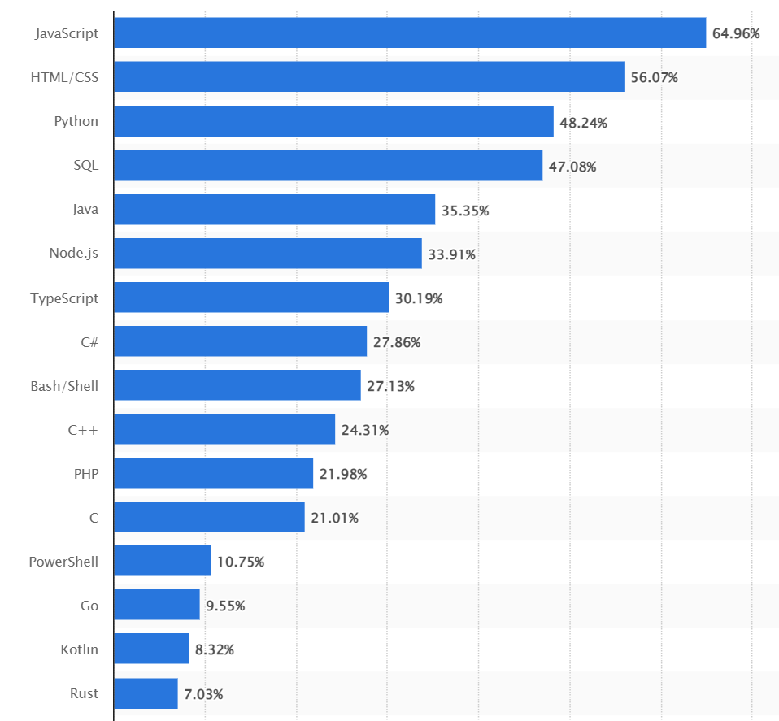
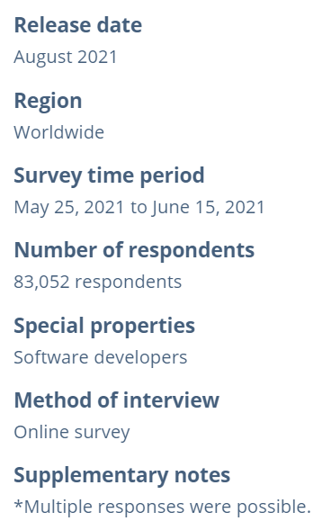
Why C++?
Widely used
https://www.statista.com/statistics/793628/worldwide-developer-survey-most-used-languages/

Slide 8
Why C++?
TIOBE Index for May 2022
Python
C
Java
C++
C#
Visual Basic
JavaScript
Assembly Language
SQL
PHP
Widely used
TIOBE Index
“Ratings are based on the number of skilled engineers world-wide, courses and third-party vendors. Popular search engines such as Google, Bing, Yahoo!, Wikipedia, Amazon, YouTube and Baidu are used to calculate the ratings.”
https://www.tiobe.com/tiobe-index/

Slide 9
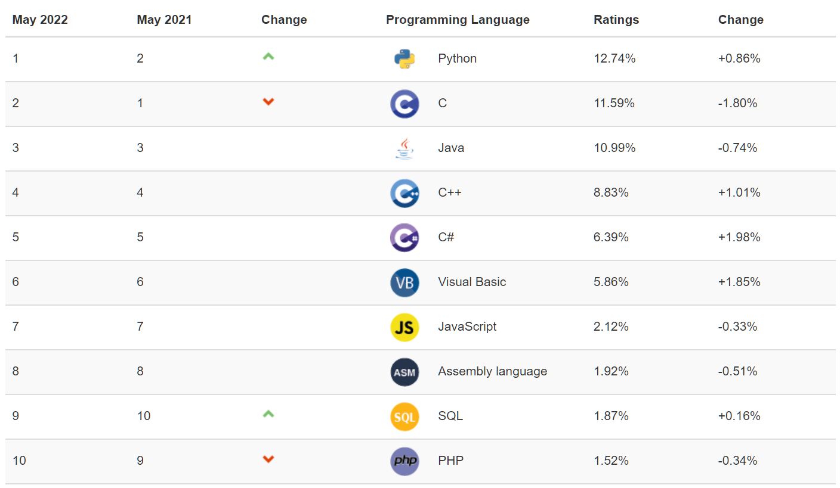
TIOBE Index for May 2022
https://www.tiobe.com/tiobe-index/

Slide 10
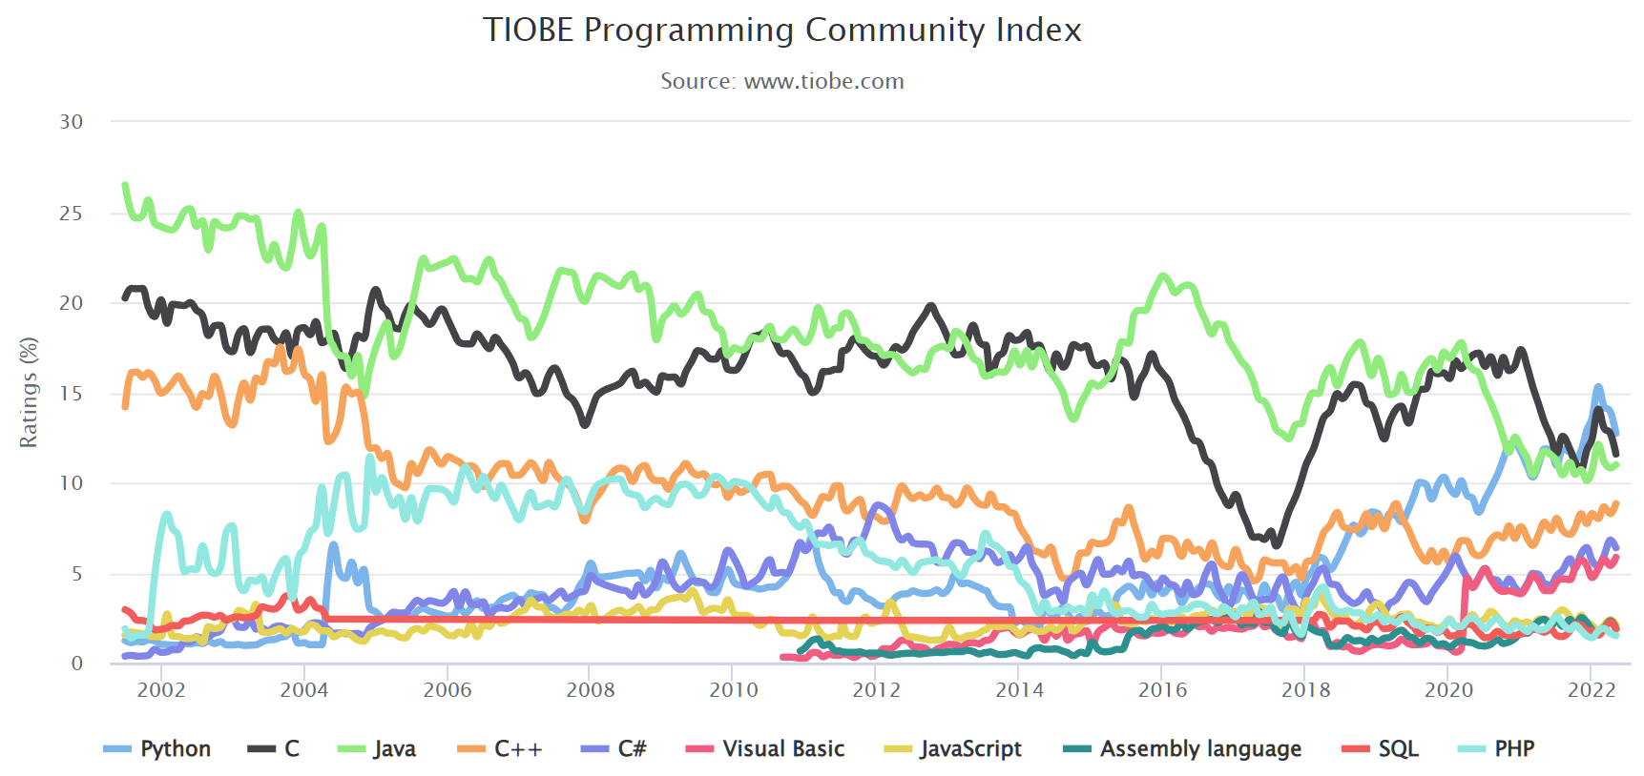
https://www.tiobe.com/tiobe-index/

Slide 11
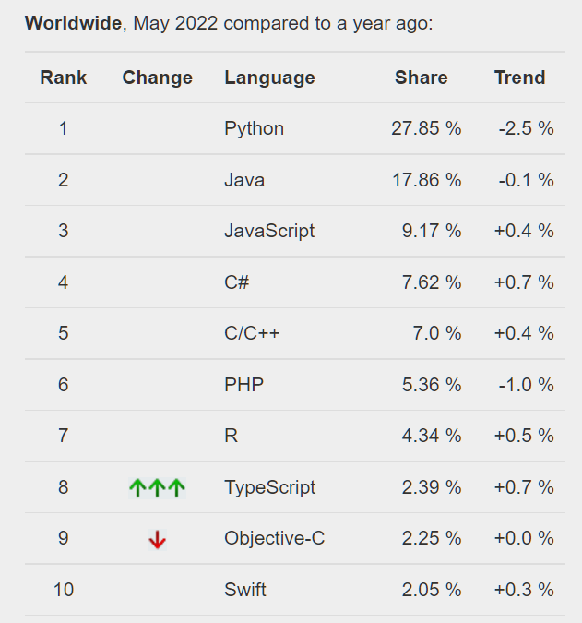
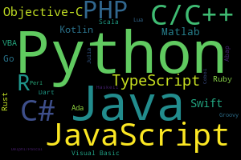
Why C++?
Widely used
PYPL PopularitY of Programming Language
“The PYPL PopularitY of Programming Language Index is created by analyzing how often language tutorials are searched on Google.”

Slide 12
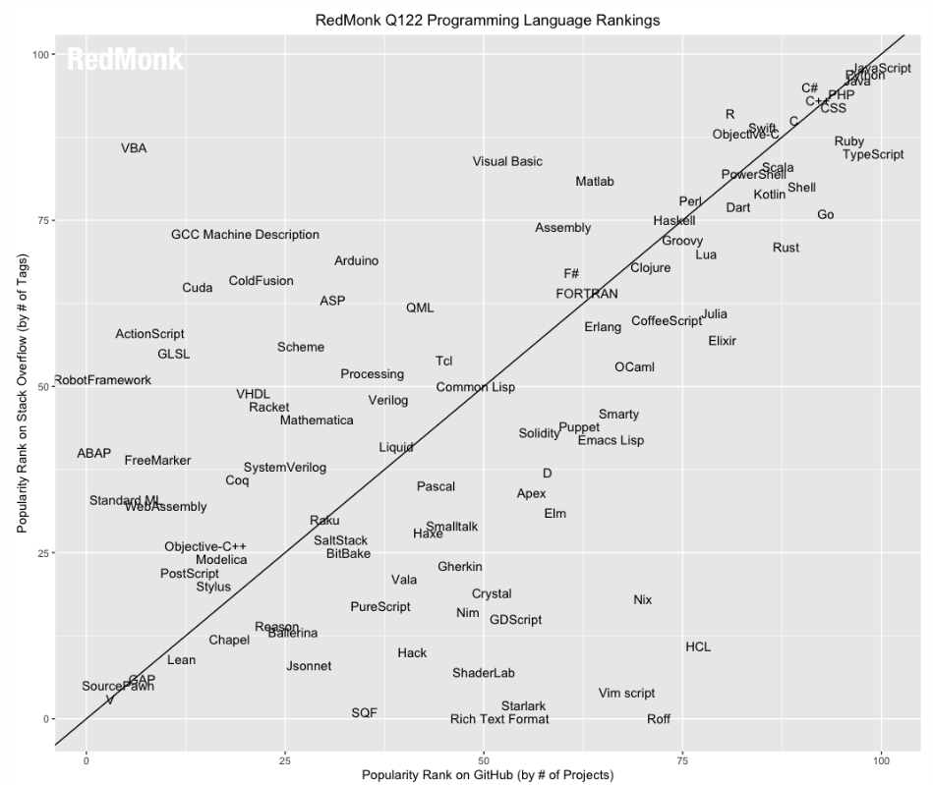
Why C++?
Widely used
RedMonk
JavaScript
2 Python
3 Java
4 PHP
5 CSS
5 C#
7 C++
8 TypeScript
9 Ruby
10 C
https://redmonk.com/sogrady/2022/03/28/language-rankings-1-22/

Slide 13
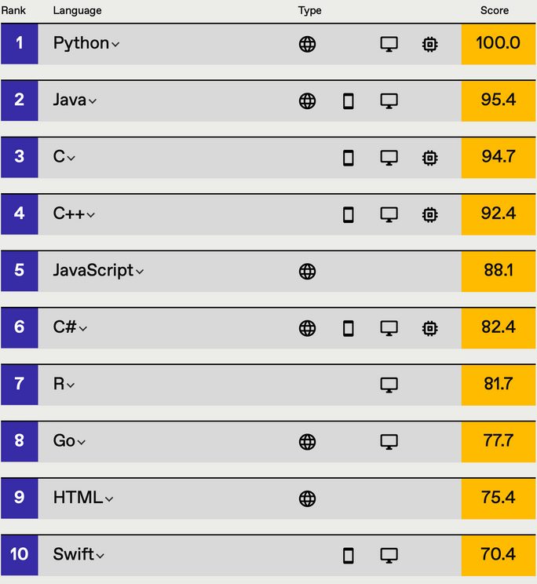
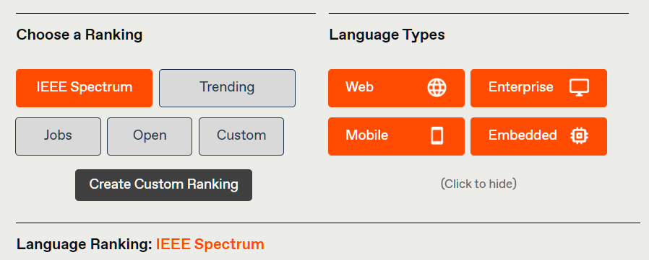
Why C++?
Widely used
IEEE Spectrum
“Rankings are created by weighting and combining 11 metrics from eight sources: CareerBuilder, GitHub, Google, Hacker News, the IEEE, Reddit, Stack Overflow, and Twitter.”
https://spectrum.ieee.org/top-programming-languages/

Slide 14
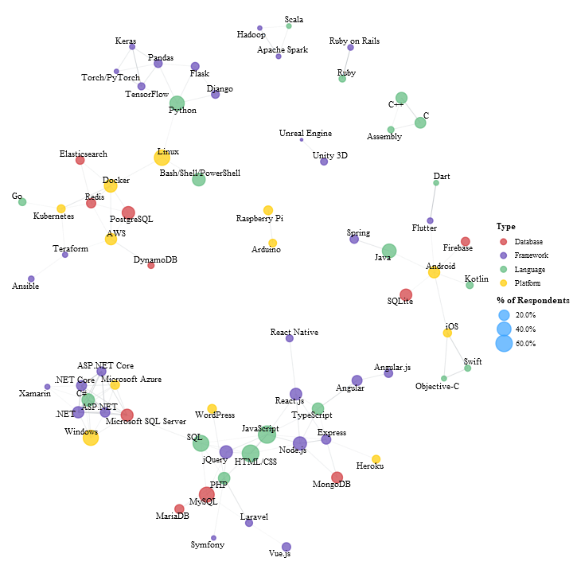
Why C++?
Widely used for embedded systems and operating systems
https://insights.stackoverflow.com/survey/2020#correlated-technologies

Slide 15
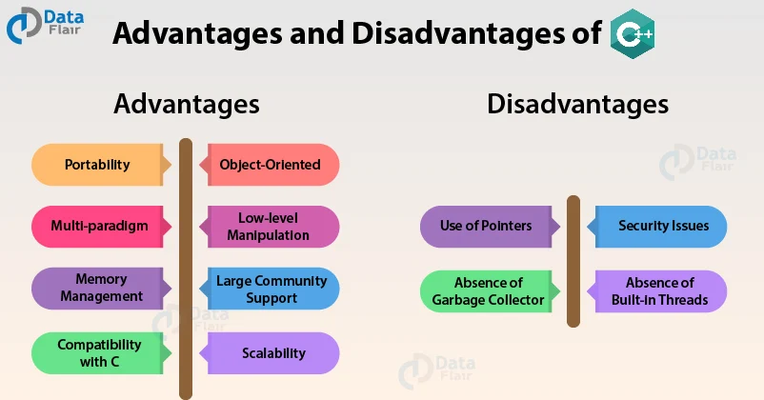
Why C++?
Efficient
Compiled
https://data-flair.training/blogs/advantages-and-disadvantages-of-cpp/

Slide 16
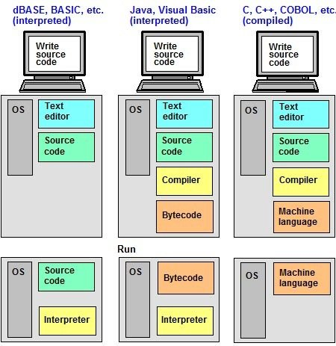
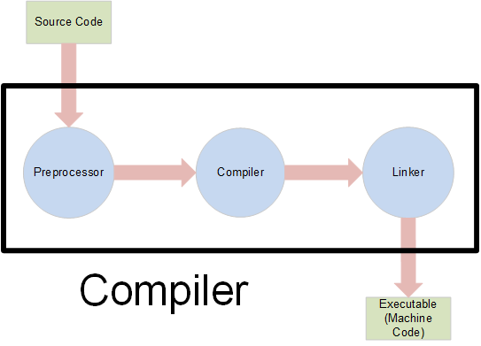
C++ Implementation
https://www.pcmag.com/encyclopedia/term/interpreter
https://icarus.cs.weber.edu/~dab/cs1410/textbook/1.Basics/compiler_op.html

Slide 17
Questions?

